Slide 1
Flashcard Exchange
Sprint 1
Tripp Barker

Slide 2
Problem Identification
Students and educators often struggle with efficiently creating, organizing, and retaining study materials, leading to ineffective learning experiences. Traditional flashcard methods are time-consuming, and many digital alternatives lack intelligent features that tailor content to users' study needs. Additionally, studying in isolation can hinder motivation and knowledge retention.

Slide 3
Significance and Impact
The Flashcard Exchange addresses these challenges by integrating AI-driven content generation, enabling users to quickly create customized flashcards from text input. This automation reduces manual effort, allowing learners to focus on comprehension rather than material preparation. Moreover, the platform fosters a collaborative learning environment where users can follow and interact with peers, enhancing motivation and academic success.

Slide 4
Supporting Evidence
Research shows that active recall and spaced repetition—core benefits of flashcard-based learning—significantly improve long-term knowledge retention. A study by Dunlosky et al. (2013) highlights that self-testing, such as using flashcards, is one of the most effective study techniques. Additionally, social learning theories suggest that peer engagement and knowledge sharing contribute to deeper understanding and higher retention rates.
https://pcl.sitehost.iu.edu/rgoldsto/courses/dunloskyimprovinglearning.pdf

Slide 5
User Stories
As a user I…
need to be able to login into and manage my account
would like to be able to follow other users
want to be able to create and manage my own flashcard decks
want to be able to save flashcard decks that other users have created
need to be able to study flashcard decks
want to be able to search for flashcard decks by topic/title
like to be able to rate flashcard decks
need to be able to report abusive content
Notes:
As a user, I need to be able to sign up and create a profile for Flashcard Exchange, so that I can use the site.
- User can sign up with username, password, and email
- User can verify account when they click verification link emailed to them As a user, I need to be able to login/out of Flashcard Exchange, so that I can access my account.
- User can login to website
- User can logout of website As a user, I need to be able to recover my account, so that if I forget my password I can still use the service.
- User can click forgot password to receive a recovery link to their email
- User receives an account recovery link when they attempt to login with incorrect password too many times – account is locked after 5 invalid attempts As a user, I need to be able to delete my account, so that I can remove my data from the service.
- User can navigate to their profile and delete their account As a user, I would like to be able to follow other users, so that I can find them easier.
- User can navigate to a user and follow them
- User can navigate to a user and unfollow them
- User can navigate to their following list and unfollow a user As a user, I want to be able to create a flashcard deck, so that other users and I can use it to study.
- User can navigate to the dashboard and manually create a flashcard deck
- User can navigate to the dashboard and have AI generate a flashcard deck As a user, I want to be able to edit the cards in my flashcard decks, so that I can fix mistakes and update the deck.
- User can navigate to a deck they own and change the title
- User can navigate to a deck they own and change the description
- User can navigate to a deck they own and add new cards
- User can navigate to a deck they own and remove cards
- User can navigate to a deck they own and edit existing cards As a user, I want to be able to delete flashcard decks, so that I can make room for new decks.
- User can navigate to a deck they own and delete the entire deck As a user, I would like to be able to save other flashcard decks, so that I can easily find them to study with.
- User can navigate to a deck profile and add it to their study list
- User can navigate to a deck profile and remove it from their study list
- User can navigate to their study list and remove a deck they are studying As a user, I would like to be able to search flashcard decks by topic/rating/search terms, so that relevant decks to subjects I am studying are easier to find.
- User can navigate to the dashboard and enter a search term As a user, I would like to be able to rate flashcard decks, so that I can help better the service.
- User can navigate to a deck and rate it As a user, I need to be able to report abusive content on the site, so that the service remains user friendly.
User can navigate to a deck profile and submit a report for abusive content
User can navigate to a user profile and submit a report for abusive content
Admins can review reports
Profiles automatically get set to hidden if they are receiving a lot of reports in a short time before Admins can review

Slide 6
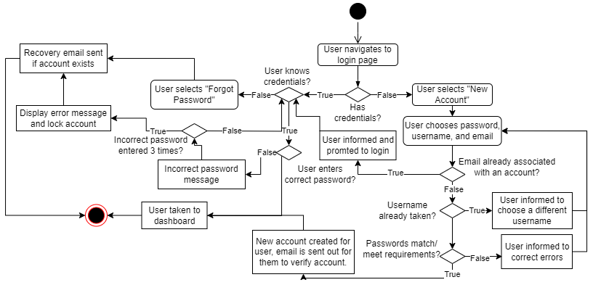
Login/New Account Activity Diagram

Slide 7
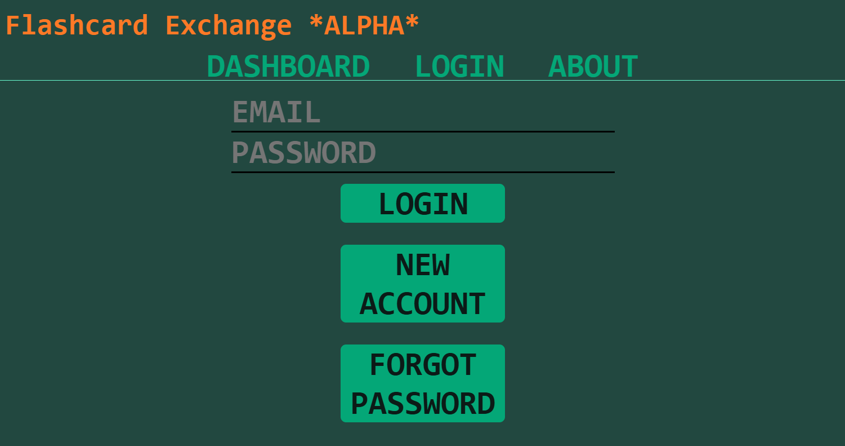
Login Page Currently

Slide 8
Login Page Tasks
Changes:
Make all buttons uniform in size/shape
Clean up UI
Add feature for user’s to be able to ‘peak’ at what they type in password field
Bugs:
No error message when incorrect password entered
Account does not lock out for too many login attempts
Color/font issue when pasting/auto filling in credentials

Slide 9
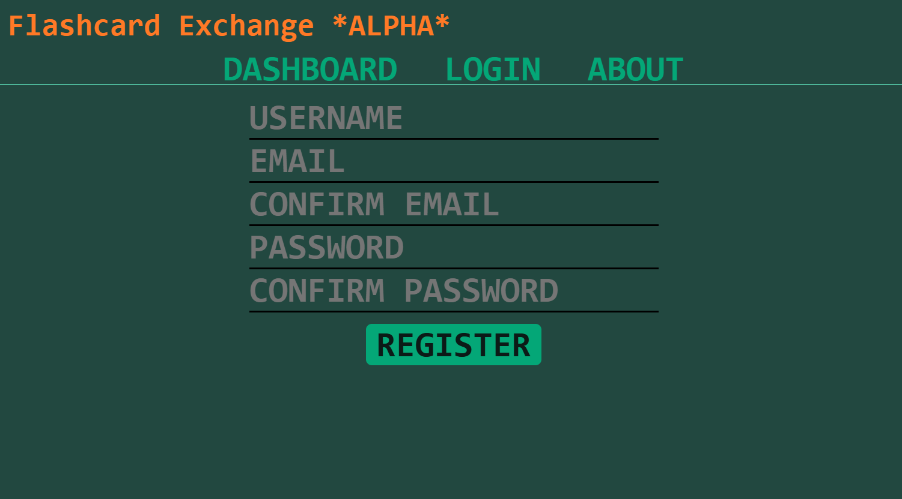
New Account Page Currently

Slide 10
New Account Page Tasks
Changes:
Clean up UI
Add feature for user’s to be able to ‘peak’ at what they type in password field
Bugs:
No error message when mismatching password entered
No error message when username is already taken
No error message when email already associated with an account
Color/font issue when pasting/auto filling in credentials

Slide 11
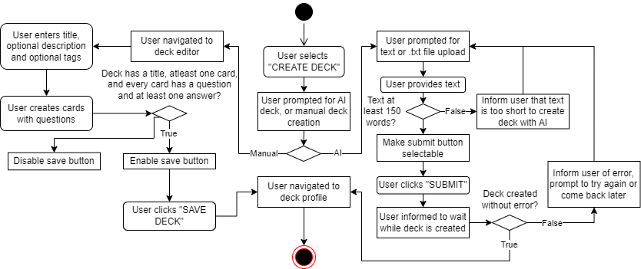
Create New Deck Activity Diagram

Slide 12
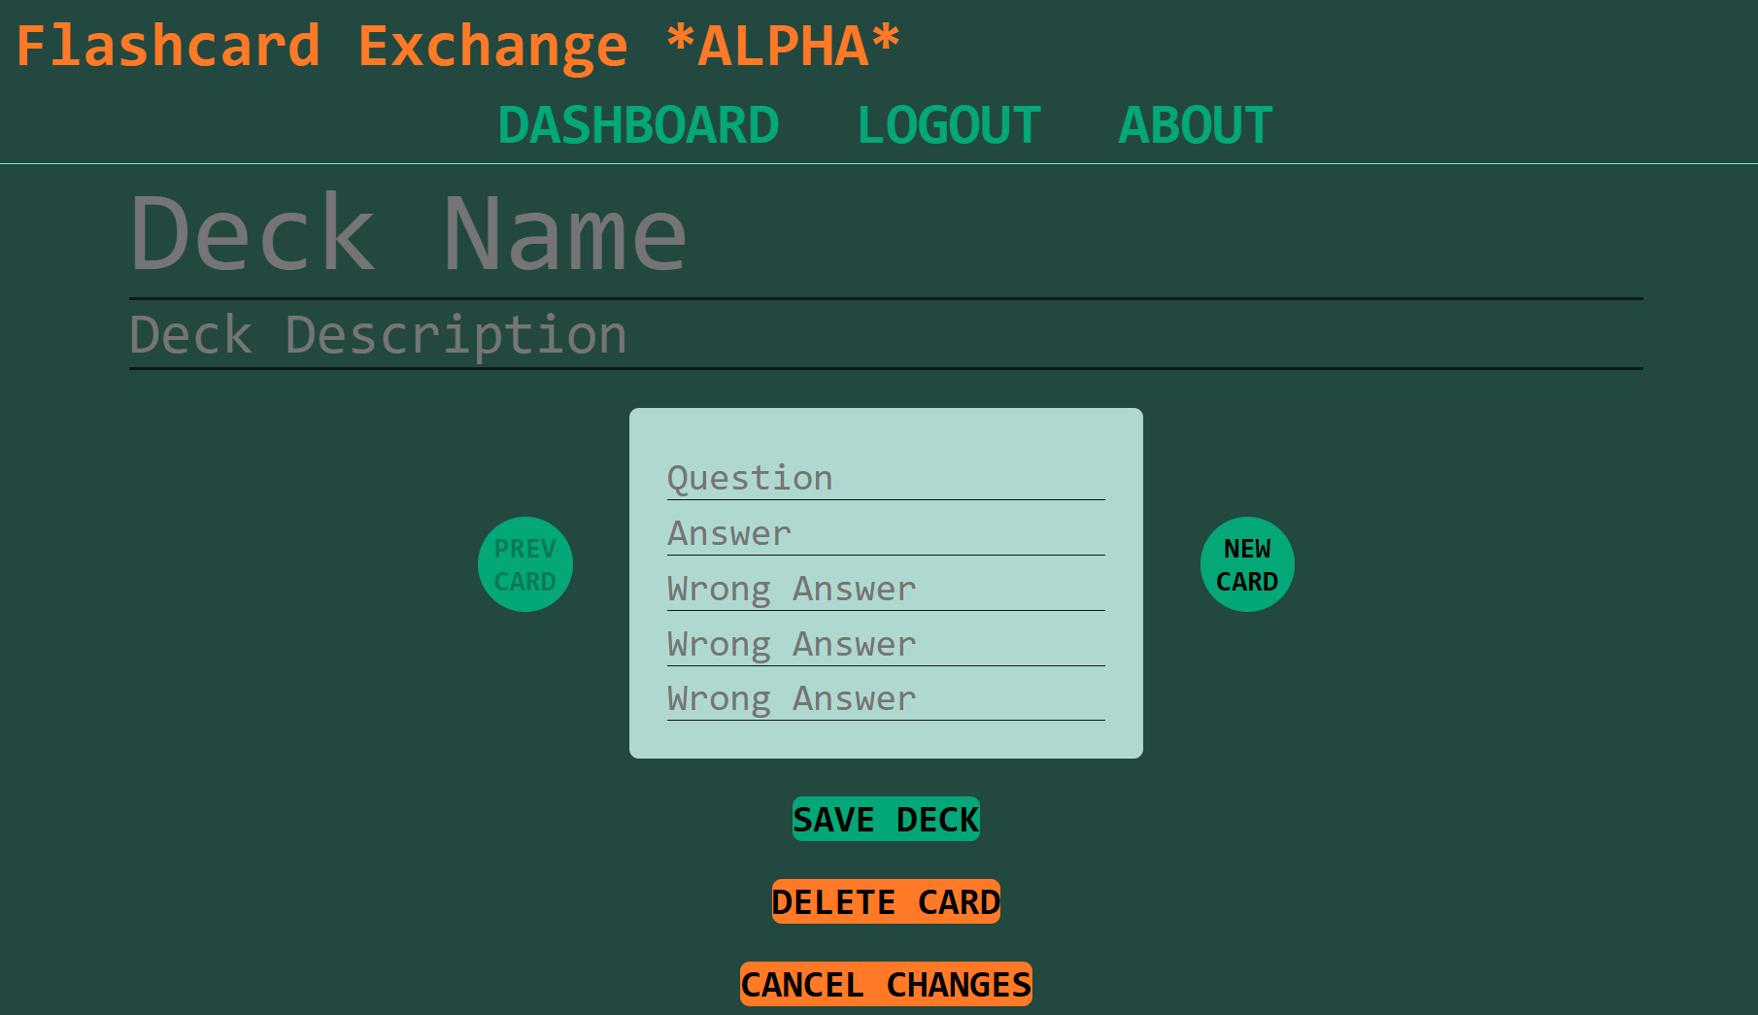
Deck Editor Page Currently

Slide 13
Deck Editor Page Tasks
Changes:
Show all cards on the page instead of flipping to a new card with left/right arrows
Add some instructions
Make buttons uniform
Bugs:
Users can create empty decks
Users can create empty cards

Slide 14
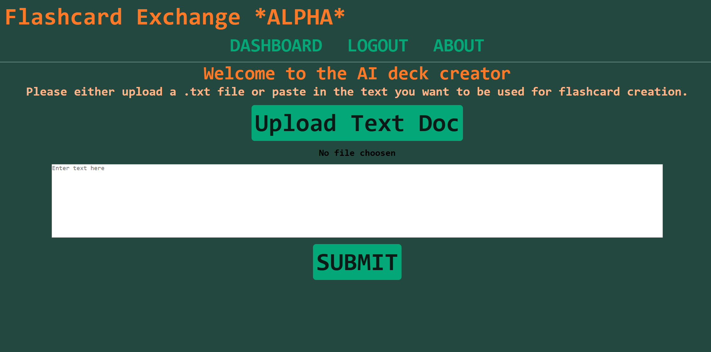
AI Deck Creator Page Currently

Slide 15
AI Deck Creator Page Tasks
Changes:
Make buttons uniform
Clean up UI
Bugs:
Users can add text docs that are too short
No error message when deck creation fails

Slide 16
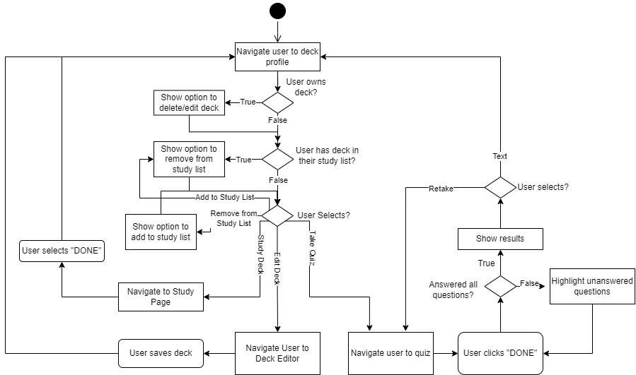
Deck Profile Activity Diagram

Slide 17
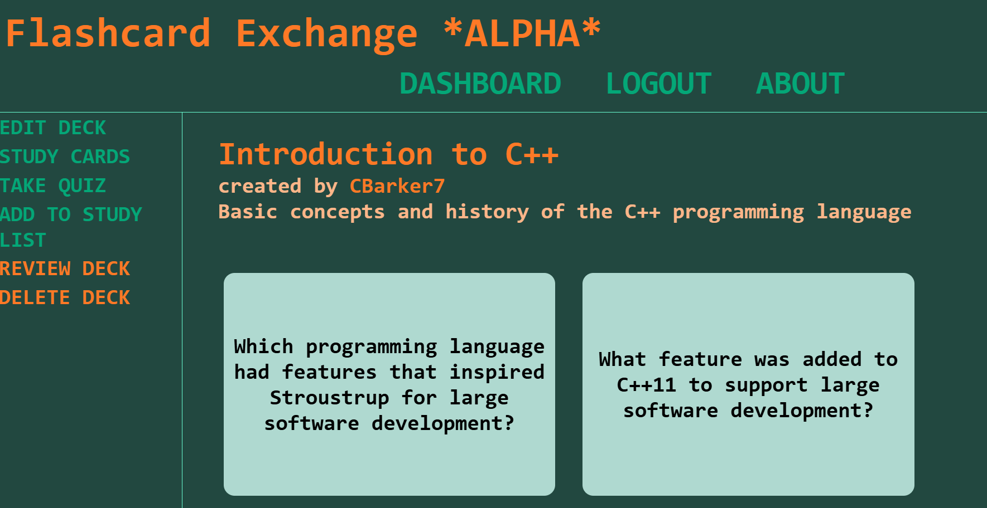
Deck Profile Page Currently

Slide 18
Deck Profile Page Tasks
Changes:
Add functionality to report deck for abusive content

Slide 19
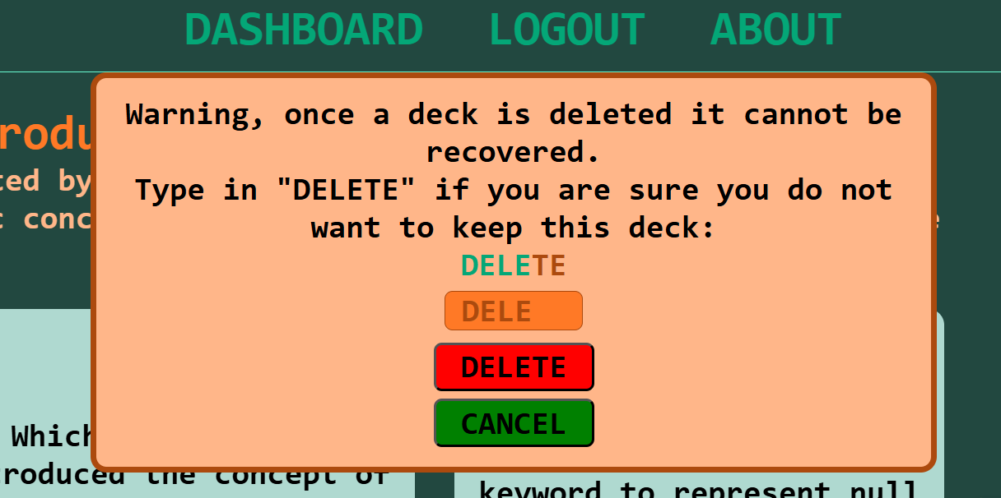
Delete Deck Window Currently

Slide 20
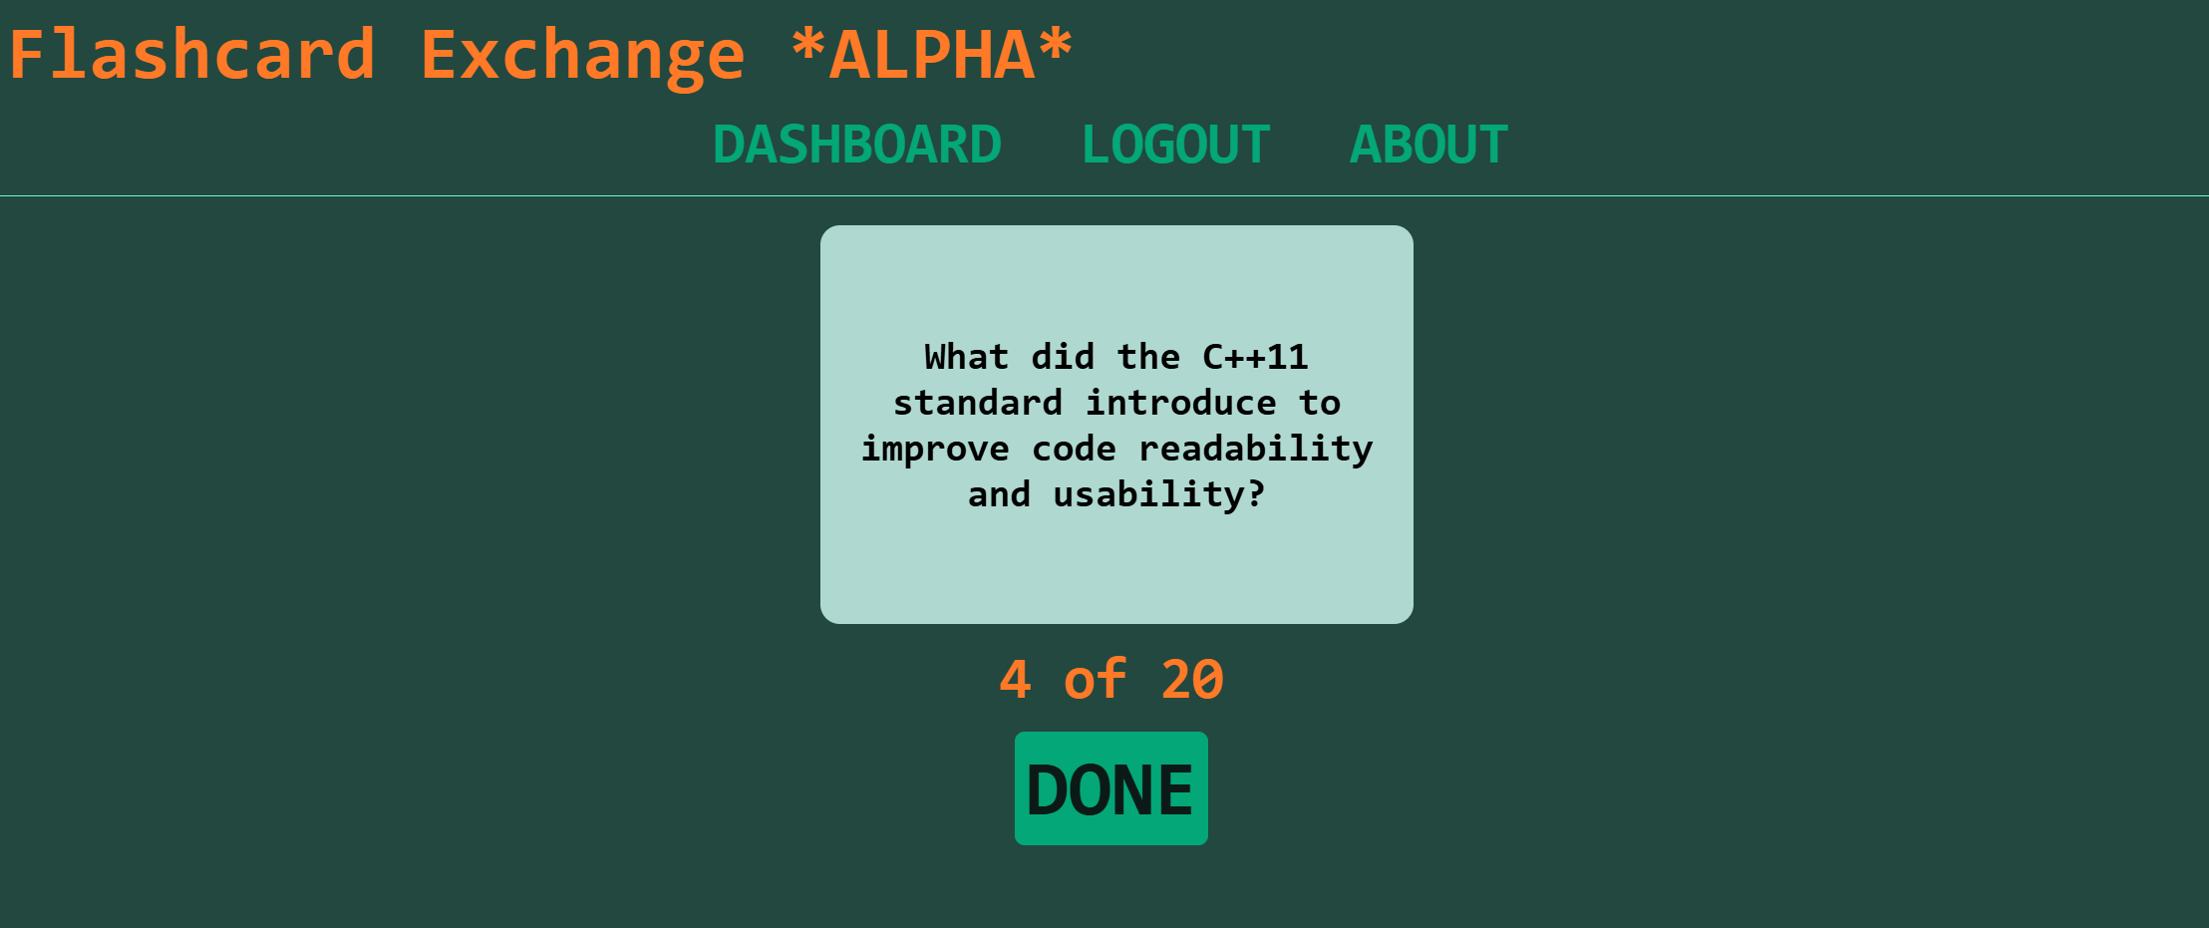
Study Cards Page Currently

Slide 21
Study Cards Page Tasks
Changes:
Work on UI
Bugs:
DONE button does not navigate user back to the deck profile – does not appear to do anything

Slide 22
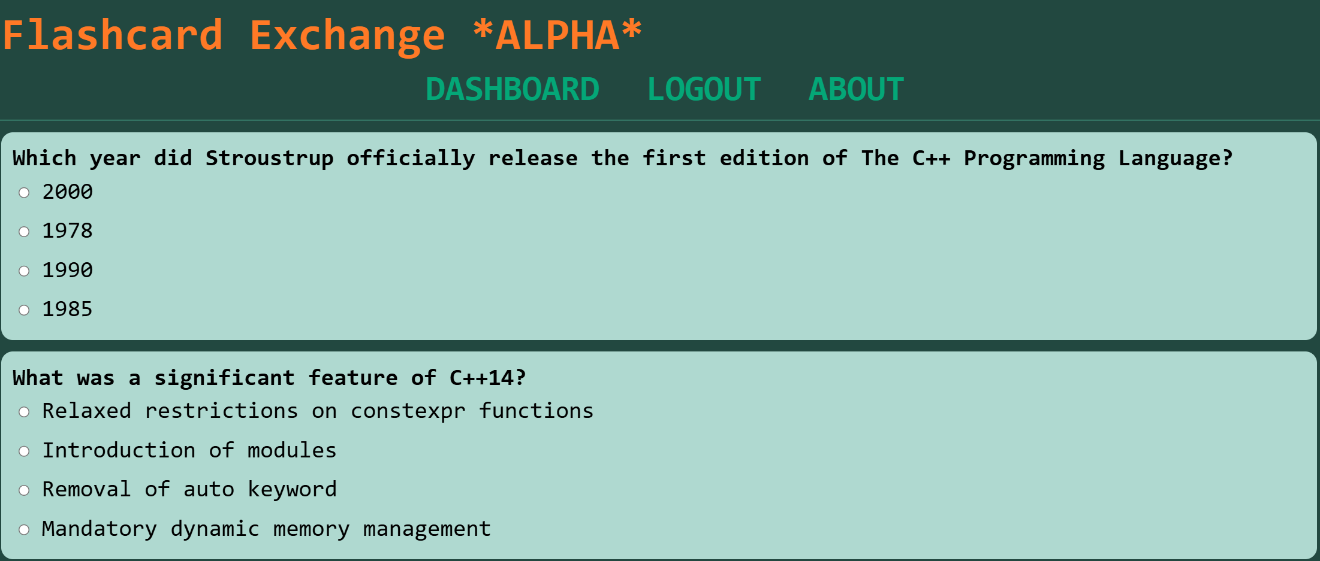
Take Quiz Page Currently

Slide 23
Take Quiz Page Tasks
Changes:
Work on UI
Bugs:
No error message when user tries to submit a quiz with missing answers
Cards with less than 4 answers still appear with 4 options

Slide 24
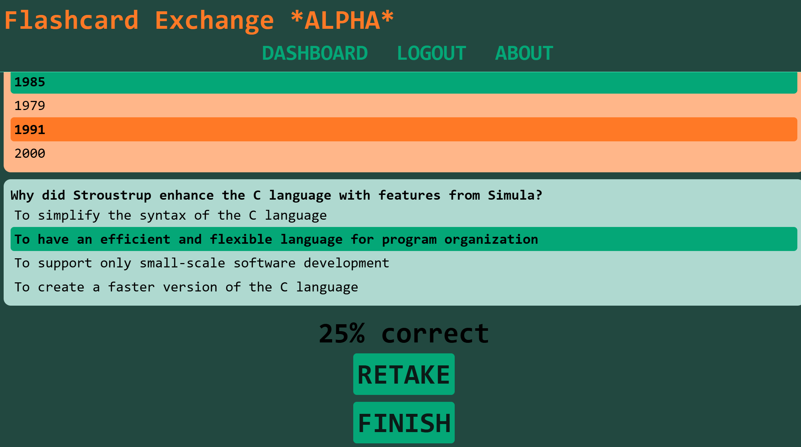
Results Page Currently

Slide 25
End

